Slide 1
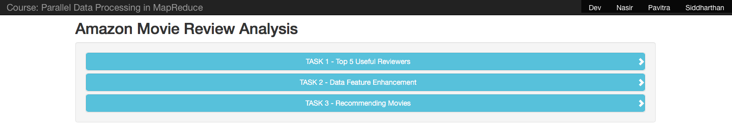
AMAZON MOVIE REVIEW ANALYSIS
-Dev pranav,nasir,siddarthan,pavitra

Slide 2
OVERVIEW
TOP K HELPFUL REVIEWERS
DATA ENHANCEMENT AND DATA CLEANING
AVERAGE REVIEW SCORE PER MOVIE
TOP MOVIES BY GENRE

Slide 3
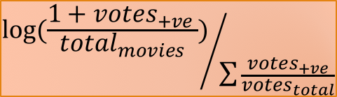
TOP K HELPFUL REVIEWERS
FORMULA:
CALCULATION OF HELPFULNESS PER REVIEWER
$${\log{(\frac{1+votes_{+ve }}{total_{movies}})}}/{\sum{\frac{votes_{+ve}}{votes_{total}}}}$$
(ID,(name,helpfulness))
{ID:avbcgdfjg,reviewer/id:eurgesf,name:jack,review/score:5.0,helpfulness:3/8,review:”interesting movie”}
…....................
SHUFFLE &
SORT
REDUCE
PART-R
MAP
REDUCE
PART-R
SORTING BASED ON HELPFULNESS
TOP K REVIEWERS
Dataset
MAP
REDUCE
PART-R
MAP
REDUCE
PART-R

Slide 4
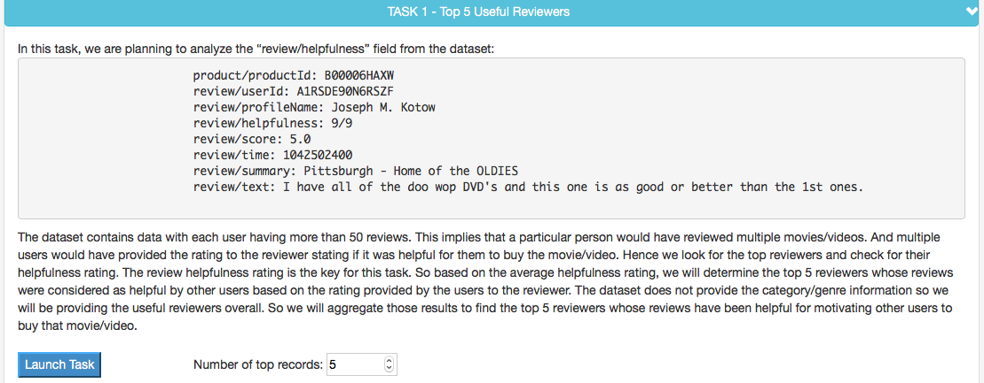
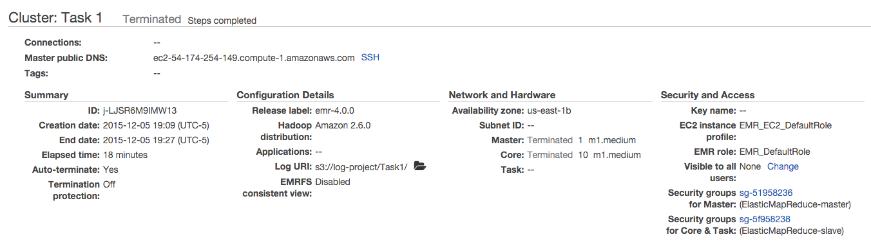
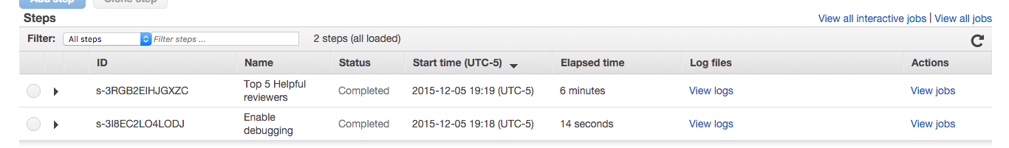
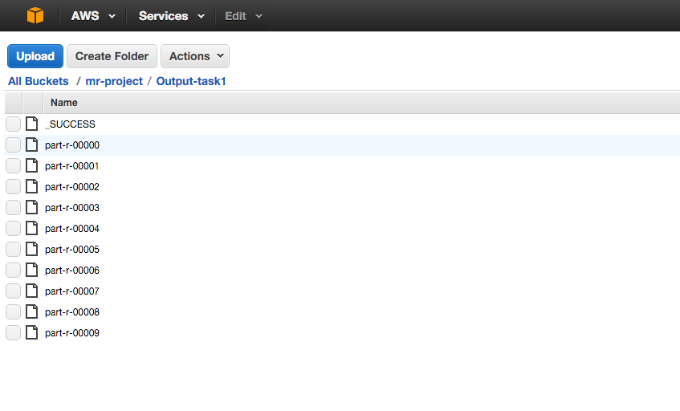
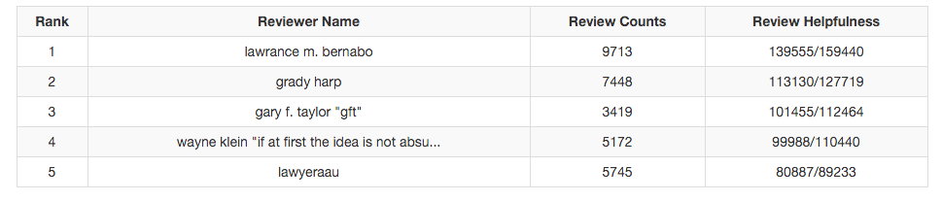

Slide 5

DATA ENHANCEMENT AND DATA CLEANING
CALCULATION OF AVERAGE SCORE
(ID, review/score)
{ID:avbcgdfjg,reviewer/id:eurgesf,name:jack,review/score:5.0,helpfulness:3/8,review:”interesting movie”}
…....................
PRODUCT ID →
SHUFFLE &
SORT
← PRODUCT TITLE
REDUCE
PART-R
MAP
PART-R
REDUCE
ID TITLE AVG_SCORE
ID TITLE AVG_SCORE
ID TITLE AVG_SCORE
.
.
.
Dataset
MAP
PART-R
REDUCE
MAP
REDUCE
PART-R

Slide 6
CONTD.
OMDB API
The Open Movie Database
RETRIEVING MOVIE DETAILS FROM OMDB
(12-ANGRY MEN,(ID,AVG))
CANONICALIZATION:
12-ANGRY MEN
12-ANGRY MEN [VHS]
12-ANGRY MEN [DVD]
12-ANGRY MEN [COLLECTOR EDITION]
PRODUCT TITLE →
SHUFFLE &
SORT
← OMDB RESPONSE
PART-R
{"Title": "Avatar",
"Year": "2009",
"Rated": "PG-13",
"Released": "18 Dec 2009",
"Runtime": "162 min", "Genre": "Action, Adventure, Fantasy",
"Language": "English, Spanish",
"Awards": "Won 3 Oscars. Another 84 wins & 106 nominations.",
"Poster": "http://ia.media-imdb.com/images/",
"imdbRating": "7.9",
"Type": "movie”}
:
:
:
REDUCE
MAP
PART-R
ID TITLE AVG_SCORE
ID TITLE AVG_SCORE
ID TITLE AVG_SCORE
.
.
.
REDUCE
MAP
PART-R
REDUCE
MAP
REDUCE
PART-R

Slide 7
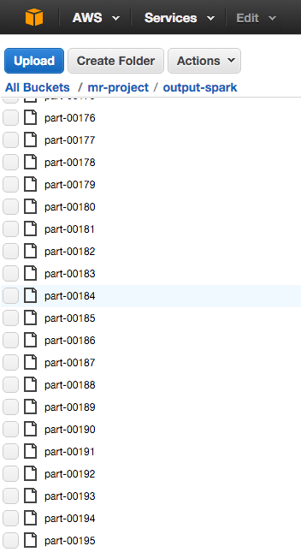


{"Title": "Avatar",
"Year": "2009",
"Rated": "PG-13",
"Released": "18 Dec 2009",
"Runtime": "162 min", "Genre": "Action, Adventure, Fantasy",
"Language": "English, Spanish",
"Awards": "Won 3 Oscars. Another 84 wins & 106 nominations.",
"Poster": "http://ia.media-imdb.com/images/",
"imdbRating": "7.9",
"Type": "movie”}
FOR PERSISTENT STORGAE
JOINING ON TITLE
ID TITLE AVG_SCORE
ID TITLE AVG_SCORE
ID TITLE AVG_SCORE
.
.
.

Slide 8
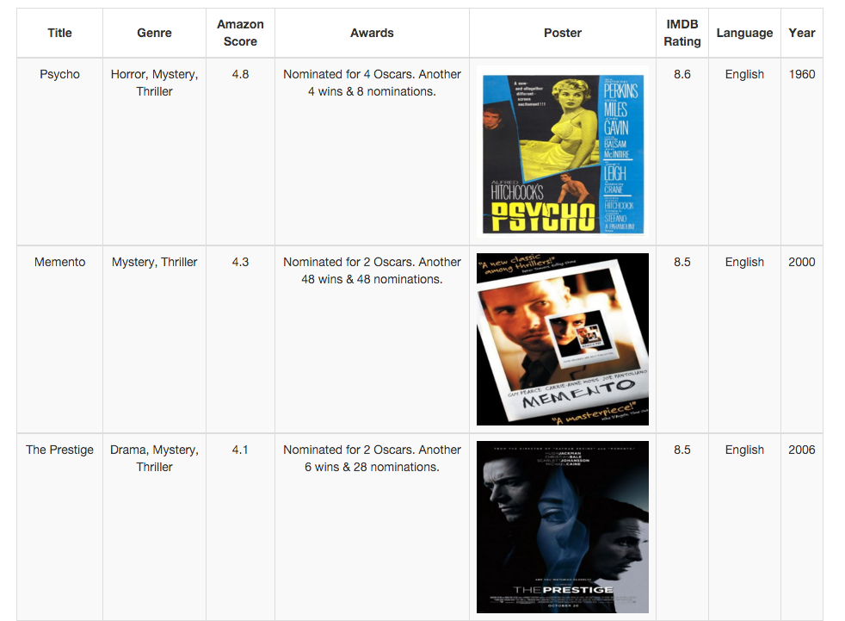
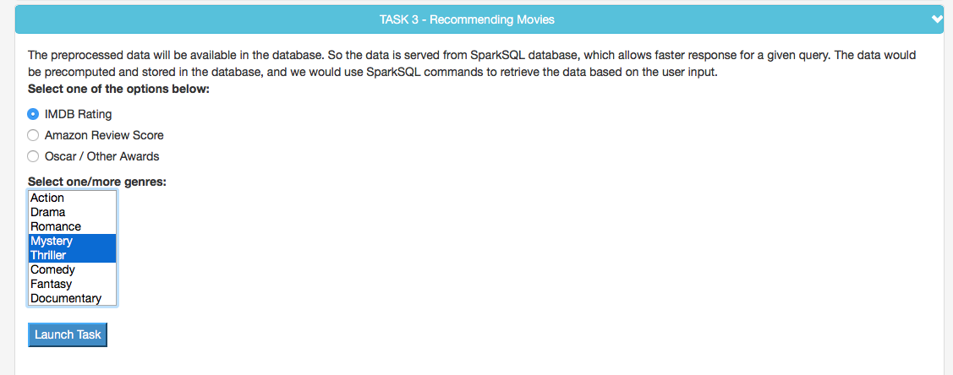
TOP MOVIES BY GENRE

Slide 9
REFERENCES
https://snap.stanford.edu/data/web-Movies.html (DATASET SOURCE)
https://aws.amazon.com/sdk-for-java/ (AMAZON AWS SDK)
http://www.omdbapi.com/ (OMDB API)
http://spark.apache.org/sql/ (SPARK SQL)

Slide 10
THANK YOU!

